Slide 1
HEARING PROTECTOR FIT-TESTING REQUIREMENT IN THE DEPARTMENT OF DEFENSE December 2023
UNCLASSIFIED

Slide 2
INTRODUCTION
UNCLASSIFIED
Significant updates to the Department of Defense Instruction (DoDI) 6055.12 “Hearing Conservation Program” were published and effective 22 November, 2023.
The change includes a new requirement for hearing protector (HP) fit testing to be conducted for all DOD personnel who have documented noise exposure greater than or equal to 95 dBA 8-hour time-weighted average (TWA) and who are enrolled in a service hearing conservation program (HCP).

Slide 3
WHAT IS HP FIT TESTING?
UNCLASSIFIED
HP fit testing is a procedure used to quantitively measure the amount of noise reduction a specific hearing protector is providing a user.
HP fit testing measures the personal attenuation rating (PAR) specific to each individual ear and hearing protector.
The PAR is a real-world measurement of the overall attenuation the hearing protector provides the individual’s ear.

Slide 4
WHY SHOULD HP FIT TESTING BE CONDUCTED? (1)
UNCLASSIFIED
Reduce noise-induced hearing loss for those enrolled in HCPs
Train workers to properly fit and use hearing protectors
Identify workers at risk for noise-induced hearing loss due to inadequate hearing protector fit
Properly select worker’s hearing protectors to meet individual and environmental needs
Increase self-efficacy among workers who must wear hearing protectors

Slide 5
WHY SHOULD HP FIT TESTING BE CONDUCTED? (2)
UNCLASSIFIED
Improve training outcomes by providing real-time feedback and documentation
Motivate workers to consistently use hearing protectors in noisy environments
Optimize maintenance of hearing protector inventories; potentially reduce costs
Comply with DoDI 6055.12 and OSHA policy requirements for fitting hearing protectors, providing training, and maintaining records

Slide 6
WHY SHOULD HP FIT TESTING BE CONDUCTED? (3)
UNCLASSIFIED
Evaluate hearing conservation program effectiveness
“Train-the-trainer” to better match hearing protectors to meet individual worker needs

Slide 7
WHO WILL RECEIVE FIT TESTING AND WHEN? (1)
UNCLASSIFIED
All DOD personnel enrolled in their service HCP and exposed at or above 95 dBA 8-hour TWA will have a hearing protector fit test at the initial reference audiogram or prior to initial duty in hazardous noise areas or as soon as possible after employment begins.
When a positive Significant Threshold Shift (STS) is identified on the periodic audiogram. A hearing protector fit test will be used to evaluate the hearing protection devices, confirm adequacy of fit, and PAR for the noise environment.
When physical changes to a person’s ear canal cause poor fit of assigned hearing protection devices.

Slide 8
WHO WILL RECEIVE FIT TESTING AND WHEN? (2)
UNCLASSIFIED
When the primary type of fitted hearing protection device is no longer available (e.g. employee switches from earplugs to ear muffs).
When a single frequency 15 dB shift at 1000, 2000, 3000, and 4000 Hz occurs.
*Note: These are the minimum requirements for hearing protector fit testing in the DOD—services may institute more stringent requirements for hearing protector fit testing to better meet the needs of their respective HCP.

Slide 9
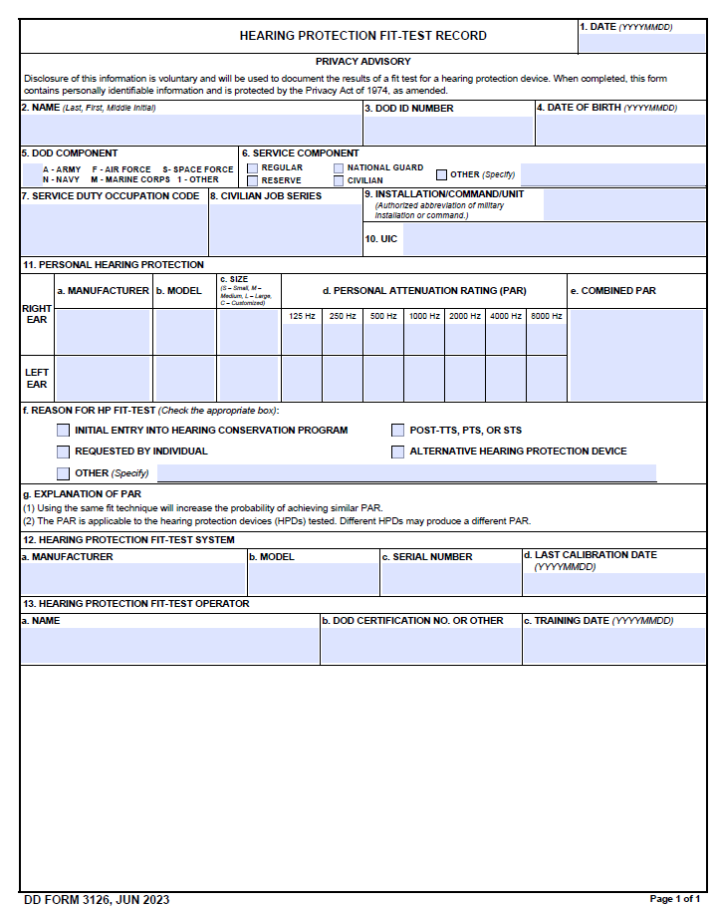
Form DD3126
UNCLASSIFIED
DODI 6055.12 requires hearing protector fit-testing results to be recorded on DD3126.
DD3126 can be found at the below link in a downloadable, fillable .pdf form.
https://www.esd.whs.mil/Portals/54/Documents/DD/forms/dd/dd3126.pdf

Slide 10
NEXT STEPS
UNCLASSIFIED
Implementation processes will be determined by each service
Equipment procurement
Personnel training to conduct fit testing
Identification of who needs to be fit tested, when to test, where to test, and how to test
Develop testing process/flow for identified personnel
Establish documentation/record keeping processes (DD3126)

Slide 11
DHA HEARING CENTER OF EXCELLENCE CONTACT
UNCLASSIFIED
Theresa Schulz, PhD
https://hearing.health.mil/hcehome/Contact-Us

Slide 12
REFERENCES
UNCLASSIFIED
Department of Defense. Hearing conservation program. Department of Defense Instruction 6055.12; 2023. https://www.esd.whs.mil/Portals/54/Documents/DD/issuances/dodi/605512p.pdf?ver=MMbEgkCmoKoUiDfYVGBtqQ%3d%3d
Department of Defense. Hearing protection fit-test record. Department of Defense Form 3126; 2023. https://www.esd.whs.mil/Portals/54/Documents/DD/forms/dd/dd3126.pdf

